Slide 1


SAP S/4HANA Training
MASTER DATA GOVERNANCE (SAP MDG)
Neeraj Gupta
Session 06
SAP MDG - Custom Data Model

Slide 2
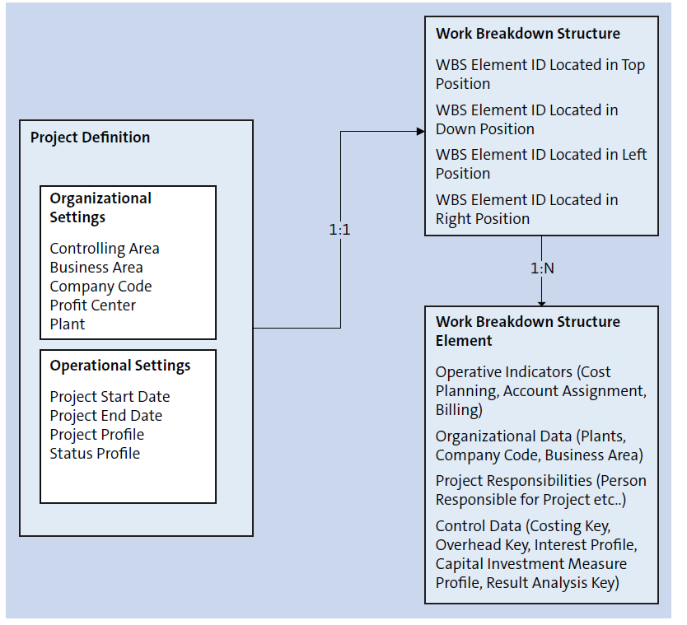
Example PS, MDG Custom Object - Conceptual Data Model
6
SAP MDG – Custom Data Model

Slide 3
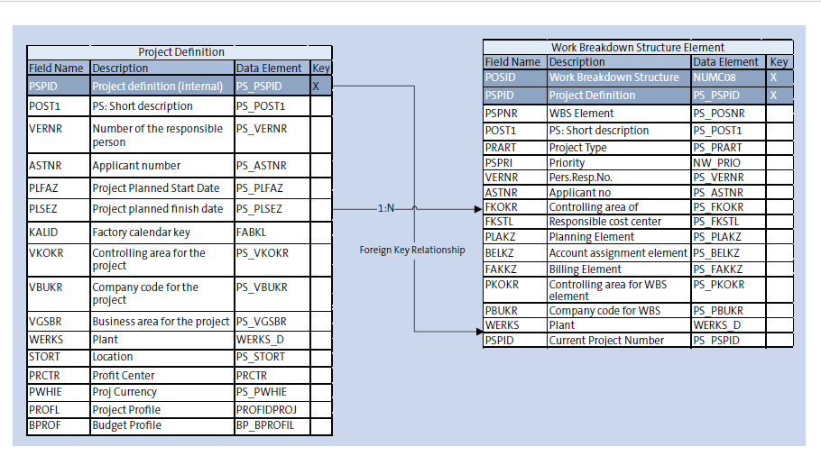
Example PS, MDG Custom Object - Logical Data Model Design Entities and Attributes, Relationships and Navigation between Entities
6
SAP MDG – Custom Data Model

Slide 4

End of Session 06

Slide 5

Questions

Slide 6

Neeraj gupta

Slide 7


We’re committed to empower you to be
Most Desirable Resource
through powerful training solutions.
We build the workforce of the future.
250+
Corporate Clients
30,000+
Learners Trained
25000+
Learners Placed
FREE WEBINARS
Sign up for free webinars with industry experts every fortnight!
Enroll Now!
Contact us today!
https://anubhavtrainings.com/

Slide 8




More from AnubhavTrainings.com

Slide 9
First Steps: Data Modelling Objects (Elements of the MDG abstract model)
6
SAP MDG – Custom Data Model
Entities
Attributes
Relationships between Entities
Metadata for UI Modelling
Staging Area – Set of generated database tables
Reuse Area in custom data model – create active area and assign an access class to the active area

Slide 10
Reuse Area in custom data model – Create active area and assign an access class to the active area
6
SAP MDG – Custom Data Model

Slide 11
Access Class Methods - defined in SE24 (Interface – IF_USMD_PP_ACCESS)
6
SAP MDG – Custom Data Model

